Slide 1
Zero-th order Frank Wolfe methods for adversarial attacks
Jacopo Magliani 2040912
Stefano Minto

Slide 2
Contents
Scope of the project
Context
Methods
Experiments
Results
Conclusion

Slide 3
Scope of the project
Developing the algorithms for Frank Wolfe Black Box and Accelerated Zero-th Order Frank Wolfe for black box adversarial attacks.
Verifying the goodness of the developed algorithms on fooling a Convolutional Neural Network on two images datasets.
Keeping the perturbations within a constrained set.

Slide 4
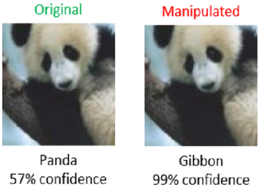
Context
Deep Neural Networks are widely used in many different areas of application but they can be easily fooled by adversarial examples, injecting noise into the input data leading to an incorrect output.
Adversary examples are difficult to recognize since the edit can appear inconsistent to the human eye.
White-box attacks can access the structure of the target DNN and perform back-propagation to calculate the gradient of the loss function with the wrong target but can generate large distorsion in the data.
We concentrate on black-box attacks, where the adversary has access only to the input and output of the model and must perform a gradient estimation. The large number of queries required for the estimation can be unfeasible in big data situation.

Slide 5
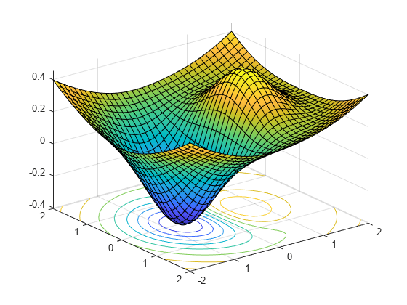
Context
Zeroth-order optimization is a subset of gradient-free optimization methods, focused on solving optimization problems without exploiting the gradient but only function evaluations.
The methods we have implemented are:
Frank-Wolfe Black Box, a variant of the original projection-free algorithm with momentum mechanism
Accelerated Zero-th Order Frank Wolfe, an evolution based on the variance reduced technique of SPIDER/SpiderBoost and a novel momentum accelerated technique.

Slide 6
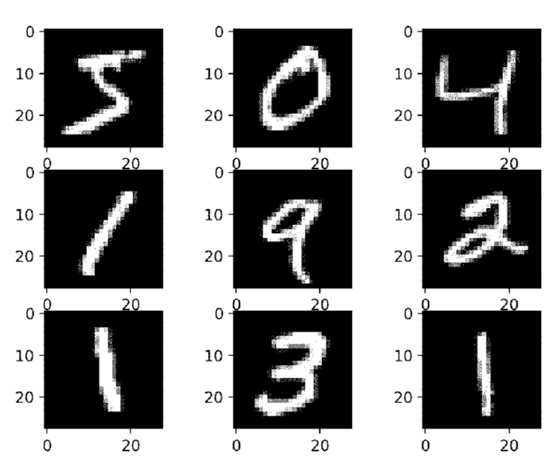
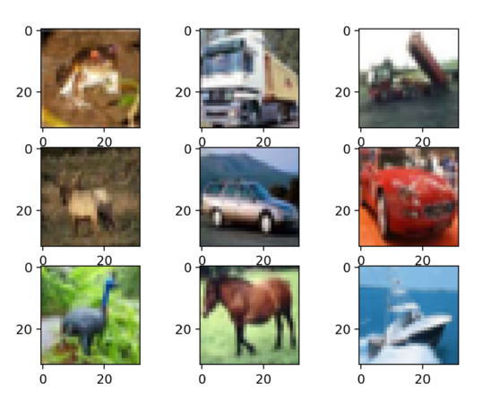
Context
The datasets we have used to train the DNN and then modified to fool them are:
Mnist: 10000 grey-scale 28x28 images representing numbers between 0 and 9
CIFAR10: 10000 RGB 32x32 images representing 10 different classes (0 -> airplane , 1 -> automobile, 3 -> bird, ...)

Slide 7



Context
We aim to minimize the loss function of the modified image with respect to the wrong target label, keeping the modification within the constrained set.
Our task was developing the algorithms of FWBB and Acc-ZOFW for the finite-sum setting, but we also tried to adapt the stochastic setting to work with a single image rather than multiples.

Slide 8
Methods
Frank Wolfe is a projection-free optimization method
It is able to keep the iterates within the constrained set
Can deal with nonconvex problems and adversarial attacks
In Black Box setting it estimates the gradient with symmetric finite differences

Slide 9
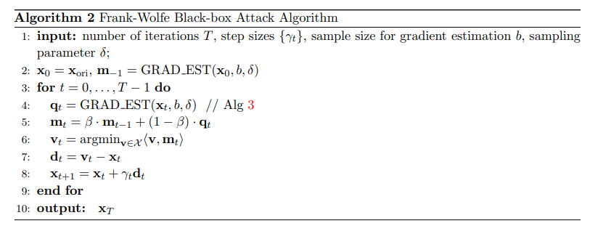
Methods
Main steps:
Initialization
Gradient estimation
Momentum
Descent direction
Updating

Slide 10
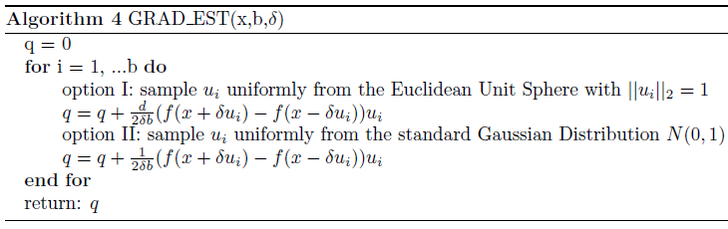
Methods
2 possible options:
Use vectors uniformly sampled from Euclidean unit sphere
Use vectors uniformly sampled from standard Gaussian distribution N(0,1)
These gradient estimations allow to get rid of back-propagation

Slide 11


Methods
FWBB needs to estimate the gradient at each iteration
It can suffer from high function query complexity and high dimension problems
A new accelerated version Acc-ZOFW was developed based on the variance reduced technique SPIDER and a novel momentum accelerated technique
It also includes two different methods for estimating the gradient
Uniform smoothing gradient estimator where u is a vector generated from the uniform distribution over the unit sphere and β a smoothing parameter.
Coordinate smoothing gradient estimator where e_{j} is vector with 1 at the j-th coordinate and 0 otherwise and μ a smoothing parameter.

Slide 12
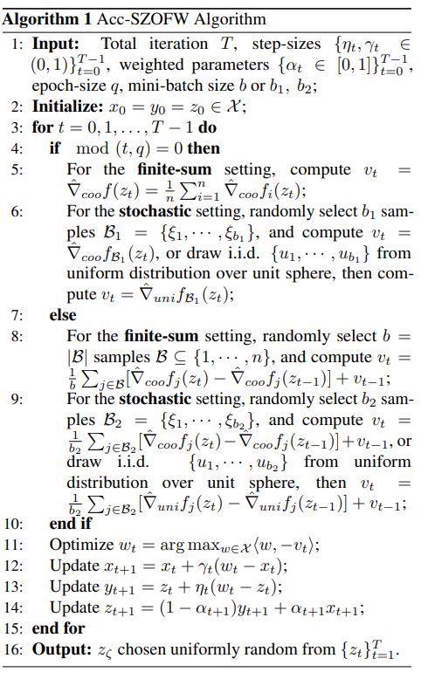

For the stochastic setting the algorithm use Spider Boost as variance reduction technique.
Depending on the setting (finite-sum or stochastic) we use Cooge or Unige as gradient estimation.
Novel momentum accelerated technique

Slide 13
Experiments
Trained a CNN model with initial accuracy of 99.12% on Mnist and 70.82% on CIFAR10 with the same configuration adopted by the authors of the papers
Selected a random subset of correctly classified images from the test sets
Adopted the Single Adversarial Perturbation setting
Used same parameters as the authors for the execution of the algorithms
Adapted stochastic setting to work with sampled pixels of the same image rather than sampling pixels from multiple images for UAP

Slide 14
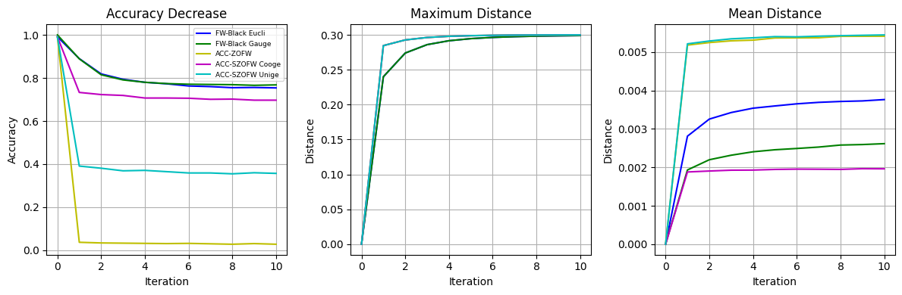
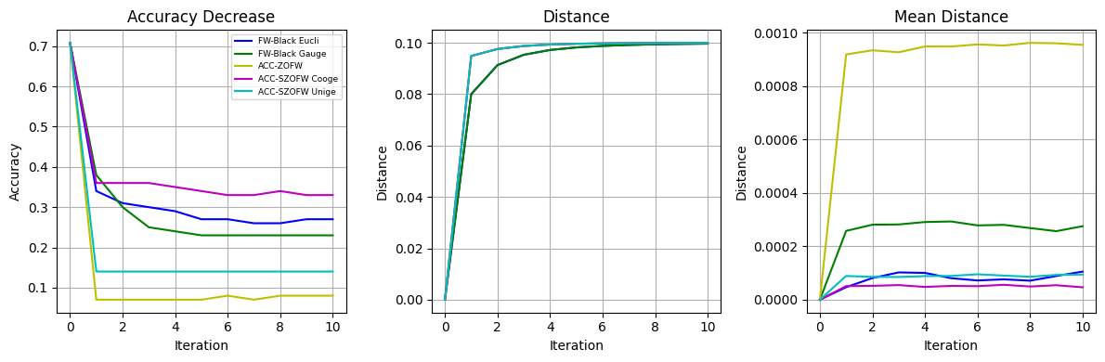
Results
 | Mnist Accuracy | CIFAR10 Accuracy
Initial | 0.99 | 0.70
FWBB Euclidean | 0.75 | 0.27
FWBB Gaussian | 0.76 | 0.23
Acc-ZOFW | 0.03 | 0.07
Acc-SZOFW Cooge | 0.69 | 0.33
Acc-SZOFW Unige | 0.35 | 0.14

Slide 15
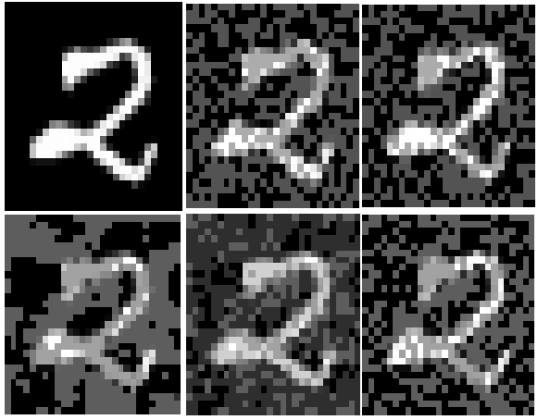
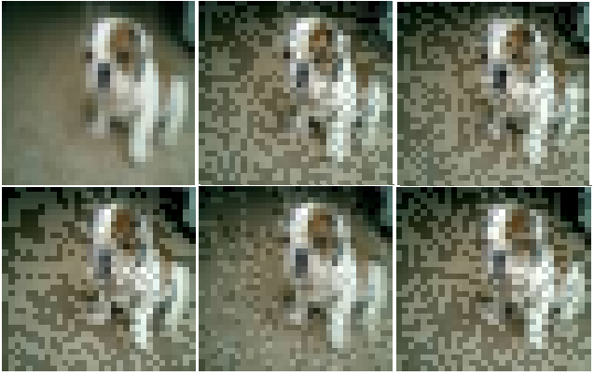
Results
From left to right: the original image, modified by FWBB (Euclidean), FWBB (Gaussian), Acc-ZOFW, Acc-SZOFW (Cooge), Acc-SZOFW (Unige)
For Mnist the model was fooled only in Acc-ZOFW setting producing an output of 5 instead of 2
For CIFAR10 the model was fooled in all the settings producing an output of 4 (deer) instead of 5 (dog)

Slide 16
Conclusions
We successfully implemented the algorithms for Frank Wolfe Black Box and Acc-ZOFW
They effectively attacked the targeted model without distorting the original input too much remaining in the boundary
Proved the improvement in the performances for the accelerated version of FWBB

Slide 17
Conclusions
Thank you for the attention
Jacopo Magliani
jacopo.magliani@studenti.unipd.it
Stefano Minto
stefano.minto1@studenti.unipd.it

